Slide 1

CYBER ATTACK DETECTION AND PREVENTION
Team No – 4
STUDENTS
PUDI SURYA VAMSI | -43731186
AKHIL KANCHI | -43731172
SOUMYA SUBHRA DATTA | -43731131
GOSU MAHENDRA | -43731159
YELURI NANDA GOPAL | -43731158

Slide 2
AGENDA
INTRODUCTION.
PROBLEM STATEMENT.
EXISTING SOLUTION.
EXISTING ARCHITECTURE.
PROPOSED SOLUTION.
PROPOSED ARCHITECTURE.

Slide 3
INTRODUCTION
Cyber attacks such as ransomware, phishing, and network intrusions are increasing rapidly and pose a serious threat to modern digital systems. Traditional security systems mainly detect attacks after they occur, which can lead to data loss and system damage.
This project introduces an AI-driven cybersecurity system that can analyze network traffic and identify abnormal patterns. The main goal is to move from reactive security to proactive security by predicting and preventing cyber attacks before they cause damage.

Slide 4
Problem Statement
Traditional cybersecurity systems rely on signature-based detection, which means they can only detect attacks that are already known. This creates a major security gap because new and unknown attacks cannot be detected. Manual monitoring of network logs is difficult, time-consuming, and prone to human error.
Key problems include:
• Cannot detect unknown or zero-day attacks • Depends on predefined rules and signatures • Manual monitoring is slow and inefficient • Delay in detecting and stopping attacks

Slide 5
Existing Solution
Existing systems use firewalls, antivirus software, and intrusion detection systems to protect networks. These systems compare network traffic with known threat signatures and block malicious activities if a match is found.
Security analysts also define rules and indicators of compromise, such as suspicious IP addresses or abnormal traffic patterns, to detect threats.
Limitations:
• Cannot predict future attacks • Cannot detect unknown threats • Requires manual rule configuration

Slide 6
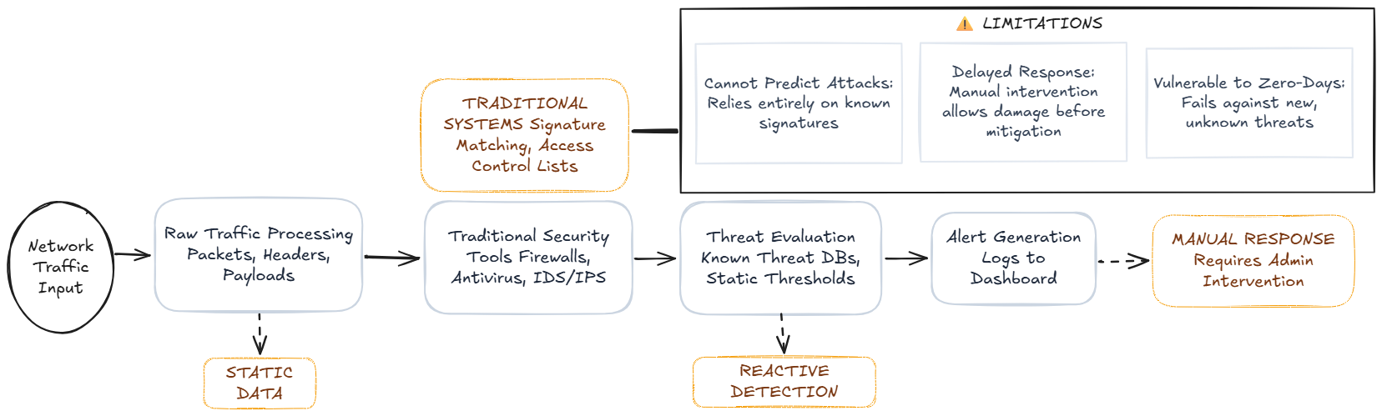
Existing Architecture

Slide 7
Proposed Solution
The proposed system uses Artificial Intelligence to analyze network traffic and learn normal network behavior. Instead of relying on predefined rules, the system automatically detects abnormal patterns.
The AI model analyzes traffic continuously and predicts potential cyber attacks before they occur. The system can also automatically block malicious activity and protect the network.
Key advantages:
• Predicts attacks before they happen • Detects unknown threats • Reduces manual work • Improves security accuracy • Provides real-time protection

Slide 8
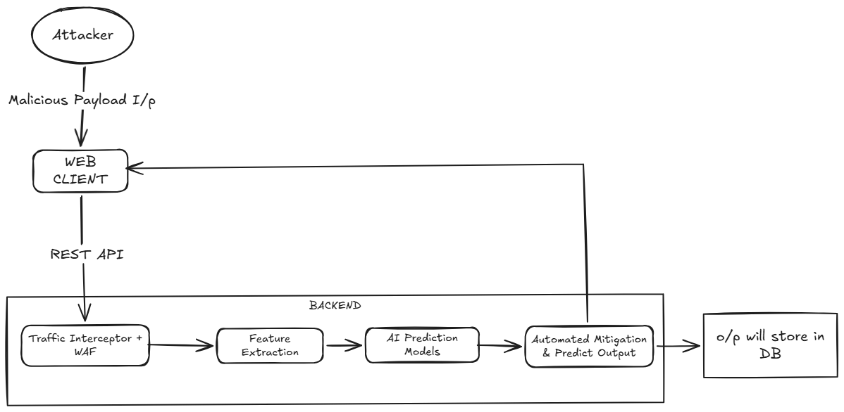
Proposed Architecture

Slide 9
Conclusion
The proposed AI-driven cybersecurity system overcomes these limitations by analyzing network traffic and learning normal behavior using deep learning models such as LSTM or RNN. The system can detect abnormal patterns, predict potential threats, and automatically prevent malicious activities.
By shifting from reactive detection to proactive prediction and prevention, the system improves threat detection accuracy, reduces manual effort, and enhances overall network security. This approach provides a smarter, faster, and more reliable solution for protecting modern digital systems from cyber attacks.

Slide 10
THANK YOU
We thank God, Our Department, Mentor, Panel Members, Supportive Professors and all Technical and non Technical staff who helped us in our Product Development.

